Slide 1
Unit 2
Economic Measurement and Indicators
GDP
Inflation
Unemployment

Slide 2
Learning Objectives Checklist
Gain an understanding of the three main macroeconomic indicators
Gross Domestic Product
Unemployment
Inflation

Slide 3


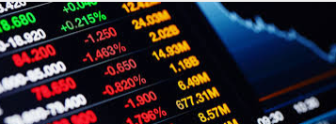
Economic Measurement
Economic Measurement is important to give governments and economists information about the economy.
How is the economy going?
What will happen in the future?
What changes can we make?

Slide 4
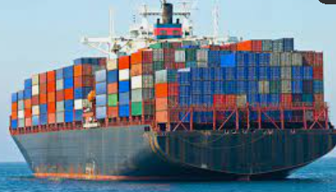
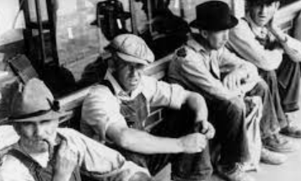
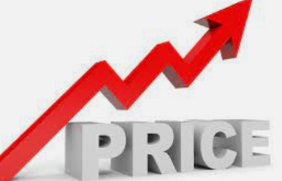
3 Crucial Economic Indicators
The three biggest economic indicators used in Macroeconomics are:
Gross Domestic Product (how big is the economy)
Unemployment (how many people have jobs)
Inflation (how stable are the prices of goods and services)
Economic Indicators
Gross Domestic Product (GDP)
Unemployment
Inflation
Unit 2
3 Economic Indicators

Slide 5
Gross Domestic Product (GDP)

Slide 6
Learning Objectives Checklist
What is the definition of:
GDP
GDP per capita
Understanding the Circular Flow Model
Product Market vs Resource Market
Full Circular Flow Model
Injections vs Leakages
Three ways of Measuring GDP
Expenditure Method
Value Added Method
Income Method

Slide 7
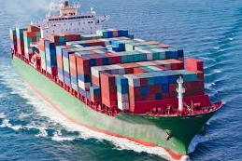

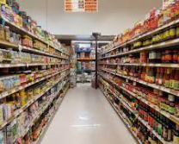
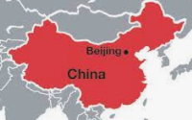
Gross Domestic Product (GDP)
One of the most important measurements is Gross Domestic Product (GDP).
We use GDP to measure the size of the economy.
Gross = all
Domestic = in the country, within the geographical borders
Product = goods and services
So GDP = all the goods and services in the country produced in one year!
In order to measure this, we have to use monetary units (US Dollars, Euros, RMB) to measure the value of the output.
Note: China’s GDP is counted as the value of goods/services produced within the borders of China.
GDP = Gross Domestic Product = The total monetary value of everything produced in the economy in one year.
Video and Interactive Quiz
http://www.econedlink.org/interactives/EconEdLink-interactive-tool-player.php?iid=204.

Slide 9
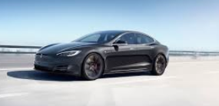



Revision: Goods and Services
What is a good and what is a service?
Goods are physical things that we can purchase and own.
Eg. Phones, Cars, cups of coffee
Services are not physical things and so we can’t own them as clearly.
Eg. A haircut, staying in a hotel, eating at a restaurant
Summary:
Good = physical
Service = not physical

Slide 10

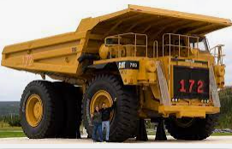

What does GDP include?
Here are some examples but not restricted to:
What consumers spend for food, clothing, housing.
What businesses spend for buildings, equipment, supplies.
What government spends to pay government employees, buy supplies, provide public services.

Slide 11


Who Measures GDP?
GDP is measured by two main government agencies:
The Bureau of Labor Statistics (BLS) collects the raw data.
The data is then calculated and analysed by the Bureau of Economic Analysis (BEA).
Summary
GDP is measured in the US by the Bureau of Labor Statistics and Bureau of Economic Analysis.

Slide 12
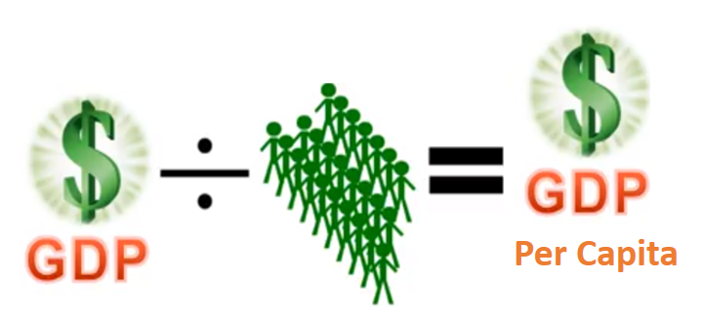
GDP per Capita
Note: A large economy such as India or China will have a very large GDP but will have a smaller GDP per capita than small wealthy countries such as Norway, Switzerland etc.
List of countries by GDP (in US dollars)
What is GDP per capita?
Output per person
Calculated by dividing GDP by total population
GDP per capita is a better indication of ‘standard of living’ than is absolute GDP. Because when output per person is high, then the average citizen will have higher income.
Summary
Per capita = per person
GDP per capita = how rich the average person is

Slide 13
What does GDP stand for?
Gross Domestic Product
What is the definition of GDP?
The monetary value of all the goods and services produced within the borders of the country within one year.
What are some examples of things counted in GDP?
Consumer spending on clothes, food, housing, education.
Firm spending on equipment.
Government spending on public goods such as police and the military.
What is GDP per capita?
It is the average production per person calculated by GDP / population.

Slide 14
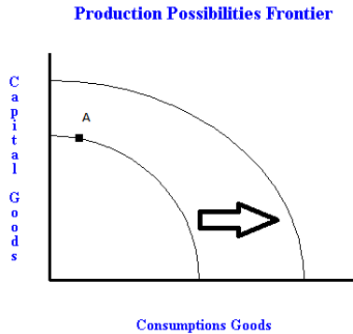

What does the GDP tell us? Economic Growth
An increase in GDP indicates economic growth.
If the GDP is larger than last year the economy is expanding.
If the GDP is smaller, the economy is contracting.
An increase in GDP can be represented on the PPC.
Because GDP shows output, out larger output on a PPC shows growth.
Summary
An increase in GDP could be shown by an increase in the PPC.

Slide 15
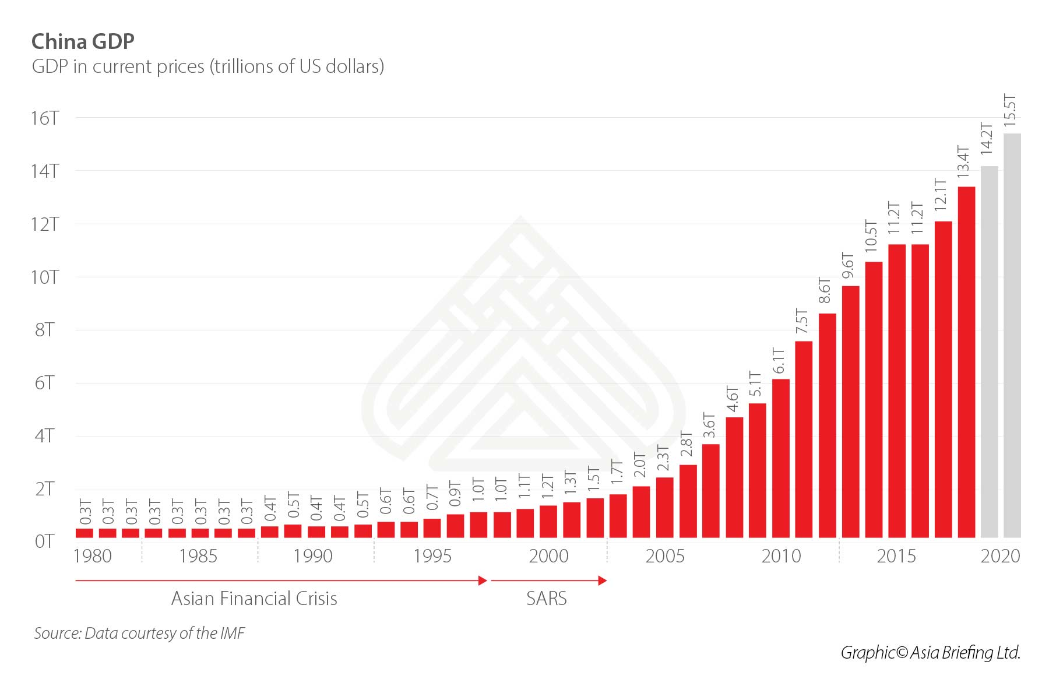

Slide 16
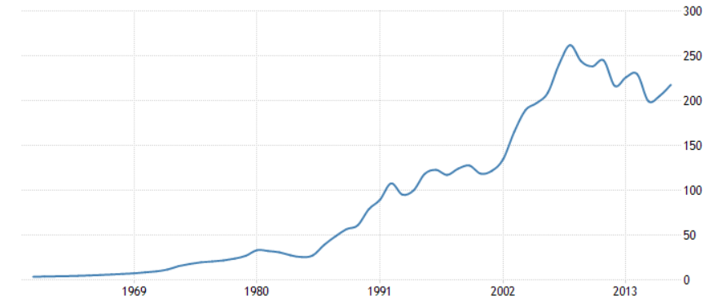
Unit 6 – External Influences in Business Activity
Chapter 24 – Government Economic Objectives and policies
Portuguese GDP

Slide 17
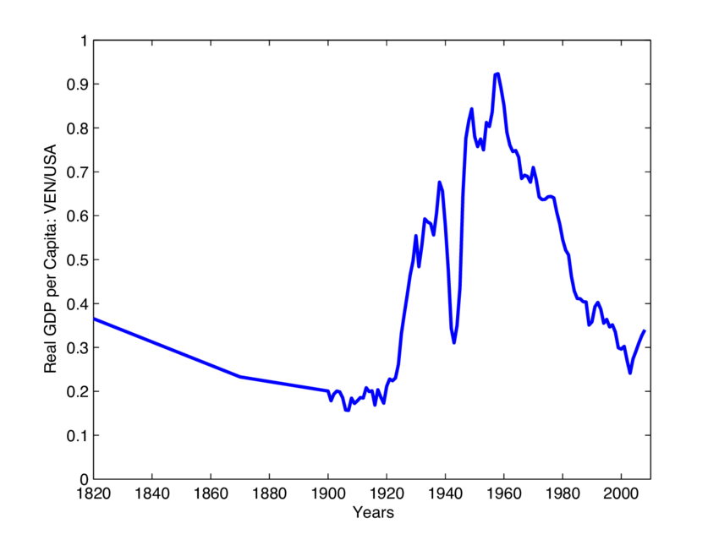
Venezuela GDP
Summary
Some countries have had steady increases in GDP but other countries less so.

Slide 18
How would we represent an increase in GDP on the PPC?
A rightward shift.

Slide 19
Lists
GDP by Country
GDP Per Capita by Country
Maps
GDP Per Capita Map
GDP Growth Around the World Map

Slide 20
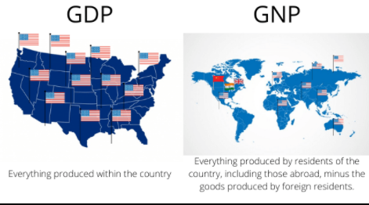
Alternate Measures of GDP
Summary
GDP measures all production within the country, citizens or not.
GNP measures production of citizens around the world.
Gross National Product (GNP) – this is the output of all citizens of a country, including people living outside of the country minus foreigners working inside the country.
I am Australian but working in China.
Am I counted in China’s GDP? –
Am I counted in China’s GNP? –
Am I counted in Australia’s GDP? –
Am I counted in Australia’s GNP? -
Yes
No
No
Yes

Slide 21
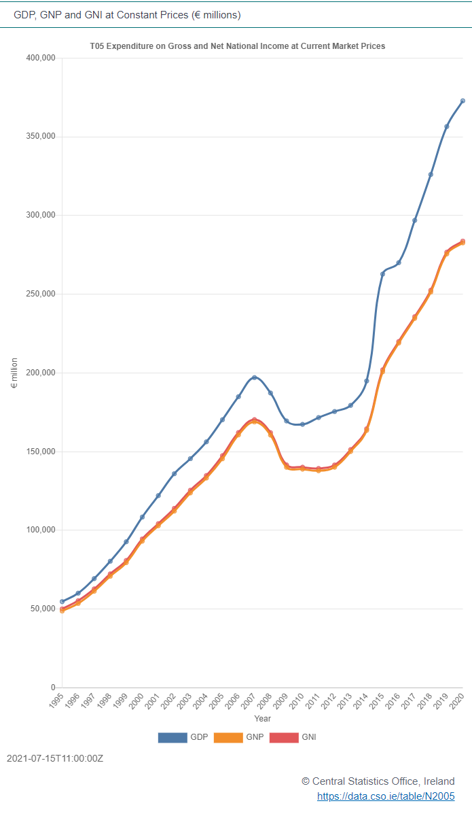
GDP, GNP, GNI?
What’s the difference between different measures?
We can see that for Ireland (West Europe), that GDP is above the GNP, indicating that there are many foreigners and foreign assets inside the country which are subtracted when we calculate GNP.
Another measure of output is also Gross National Income (GNI) which is very similar to GNP in value but has some small statistical differences that won’t be covered in this course.
For AP Macroeconomics, GDP is the focus regarding the size of economic output.
GDP
GNP
GNI
Summary
GNI and GNP are essentially the same. We will focus on GDP in this course.

Slide 22
3 Crucial Economic Indicators
The three biggest economic indicators used in Macroeconomis are:
Gross Domestic Product (how big is the economy)
Unemployment (how many people have jobs)
Inflation (how stable are the prices of goods and services)
Economic Indicators
Gross Domestic Product (GDP)
Unemployment
Inflation
Summary
We have now introduced one of the three most important economic indicators.
3 Economic Indicators

Slide 23
Circular Flow

Slide 24
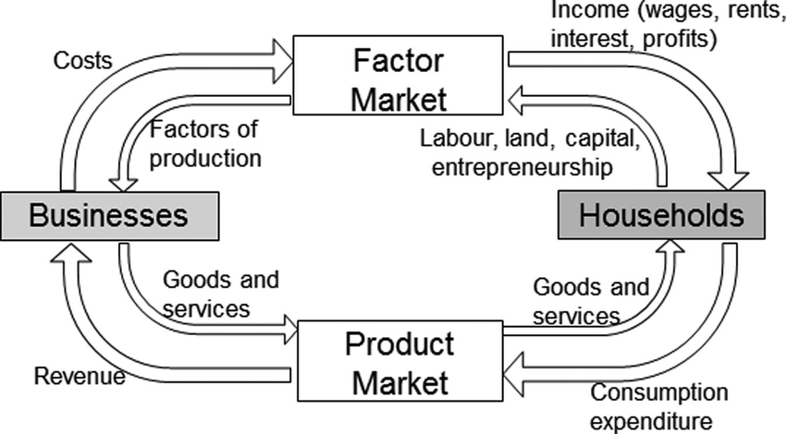
Circular Flow (Link)
The circular flow model shows a simplified version of all economic activity in a national economy.
There is a flow of goods and services and money between the different entities in the economy.
In the simplified circular flow model it is just households and businesses.
Once we have understood this basic model, we can add more entities to make the model more complex and realistic.
Businesses – buy: resources, sell: products
Households – buy: products, sell: resources

Slide 25
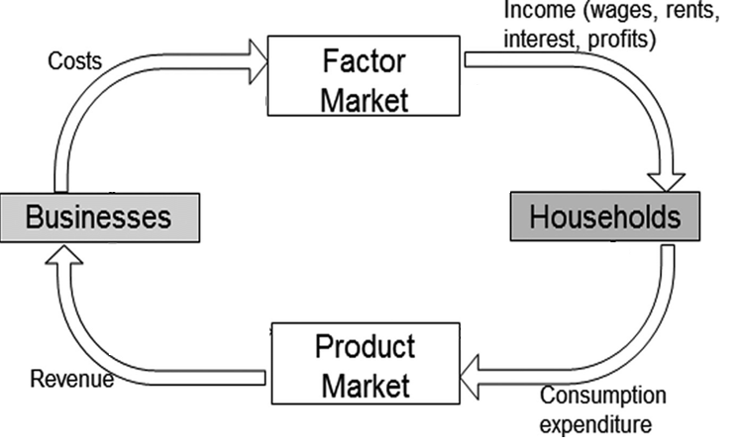
Removing the flow of Goods and Services
There is always an opposing flow of goods and services when there is a flow of money.
However, we often represent just the flow of money, so we don’t need to draw arrows going both ways.

Slide 26
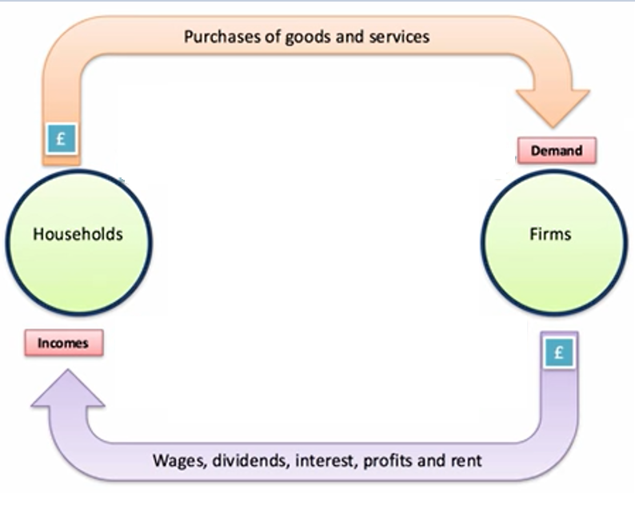
Even more simplified

Slide 27
What are the two sectors in the simple circular flow model?
Businesses
Households
Draw a simple circular flow model.

Slide 28
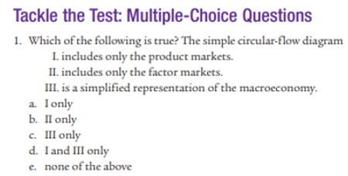
Module 10
Answer: C

Slide 29
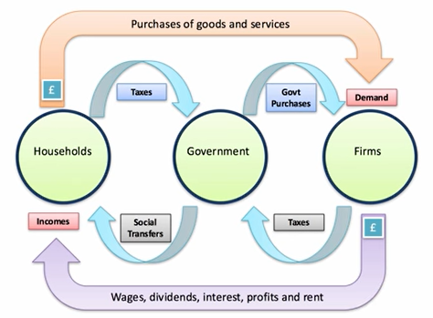
Government
The government contributes to the circular flow by:
Raising taxes
Government Expenditure
Government spending - buying G&S (goods and services)
Transfer payments (eg. assistance to the poor)
Note: Transfer payments are not government spending because they are simply taking money from one person and giving to another. Therefore they do not contribute to GDP because there is no good/service being produced.

Slide 30
How do governments raise money?
Tax which they take from businesses and households.
What do governments do with the taxes?
Government expenditure
Government spending – spending on goods and services (eg. military equipment, building roads)
Transfer Payments – transferring money from ‘rich to poor’
Note: Transfer payments are NOT counted in GDP because there are no goods and services being produced, just a transfer of money.

Slide 31
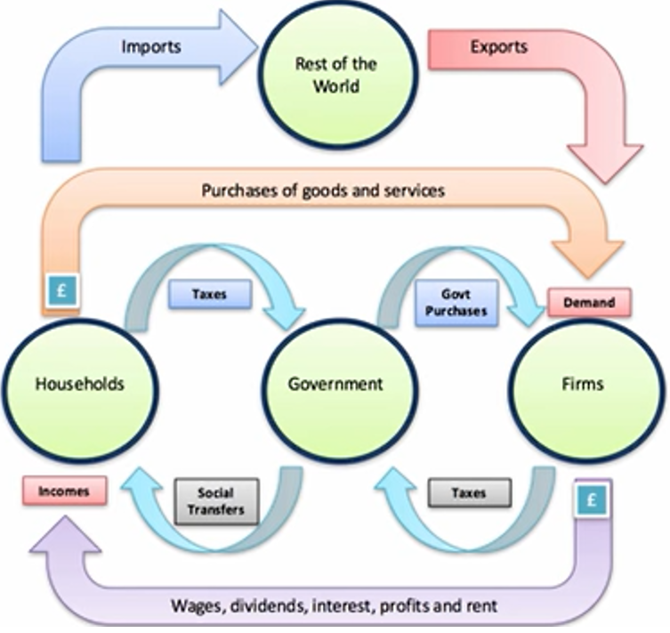
Rest of World
The rest of the world buys and sells from our country.
Imports represent money leaving the circular flow (but goods enter)
Exports represent money entering the circular flow (but goods leave)
Note: Goods and services are going the opposite direction of the money.

Slide 32
Where does the money go when imports enter the country?
Money leaves the country’s circular flow. Goods/services enter the economy.
Where does money go when exports leave the country?
Money enters the country’s circular flow. Goods and services leave the economy.

Slide 33
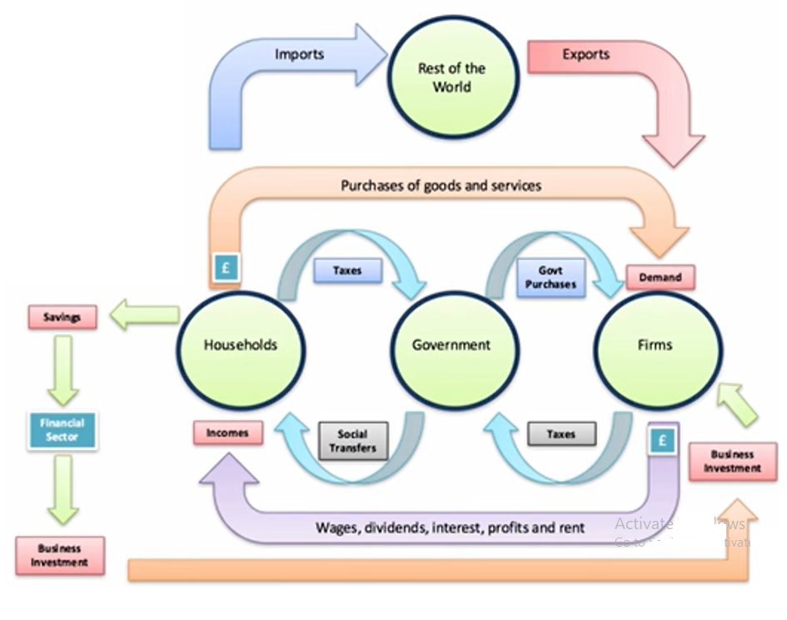

Financial Institutions
The primary function of financial institutions is to:
Take savings from individuals
Lend to businesses (and individuals) that use this borrowed money to invest in expanding production.
Capital Goods
Research in Technology
Training and hiring workers
Note: When talking about GDP, we only refer to investment as firm spending on expanding production.
We don’t focus on purely financial investment such as stocks, buying property to earn money.
Lenders and Borrowers

Slide 34
What do banks/financial institutions do?
They take savings from households
Lend it to firms who spend this in the form of investment.
What kind of investment do we focus on when talking about circular flow and GDP? And which do we tend to ignore.
Firms investing in things such as capital goods and technology that allow them to expand production.

Slide 35


Injections and Leakages in Circular Flow
Summary
Injections put money into the circular flow.
Leakages take money out of the circular flow.
These are (in the long run) equal.
Injections
It is all about the different types of spending!
Puts money in to the circular flow
There are three types of injection of extra spending into the circular flow model.
Investment in capital goods
Exports of goods and services
Government expenditure (spending and transfers)
Leakages
Are all about when money is NOT spent
Takes money out of the circular flow
There are three types of leakage or withdrawal from the circular flow.
Savings
Imports of goods and services
Taxation

Slide 36
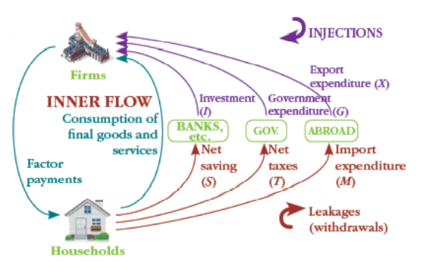
While this model is not quite as accurate, it does show more clearly the leakages and injections in the circular flow.

Slide 37
Injections – increase the amount of money in the circular flow.
Leakages – decrease the amount of money in the circular flow.

Slide 38
What are the leakages from the economy? What are the injections into the economy?
Leakages: Saving (S), Taxes (T), Imports (M)
Injections: Investment (I), Government Spending (G), Exports (X)

Slide 39
Abbreviations
Note: G only includes spending on actual goods and services.
Consumption = C
Investment = I
Government spending = G
Exports = X
Savings = S
Tax = T
Imports = M

Slide 40

Households, government, other firms, rest of world.
Households
buy from local firms
buy imports from the rest of world
sell labor
pay taxes to government
save money in financial institutions

Slide 41
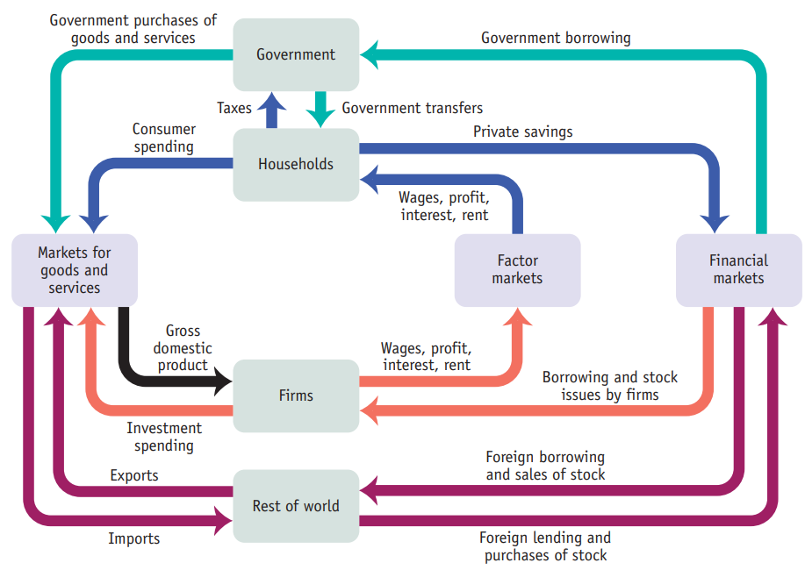
Adding two kinds of markets
To make all the flows of money more accurate and clear, we can create an additional market called and a ‘financial markets’ node.
If we look at financial markets we can see more clearly where the money is going.
Who borrows money from our banks?
Government (Government spending)
Firms (Investment)
Foreigners
Who saves money in our banks? Also these three:
Government
Firms
Foreigners

Slide 42
Describe the types of borrowing that occur within financial markets within a country’s circular flow.
The financial markets in a country can lend to:
The government
Firms
Foreigners (foreign firms, foreign governments)
Households (eg. to buy a house/car)

Slide 43
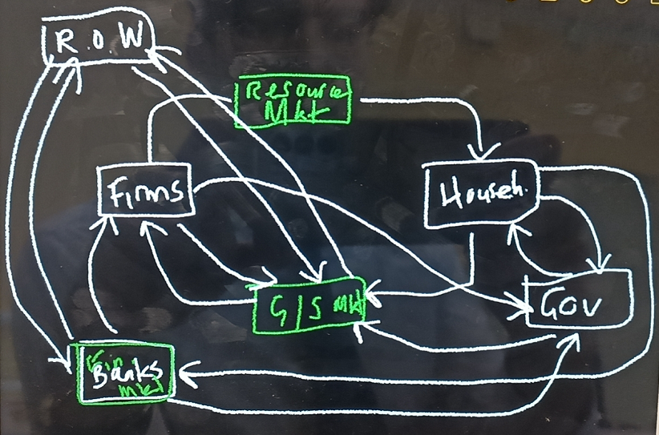
Exports
Incomes
Foreign borrowing
Imports
Corporate tax
Tax
Investment
Consumption
Transfer payments
Business Revenue
Foreign Lending
Government spending
Household Savings
Gov borrowing

Slide 44
Draw a full circular flow model
Hint:
What are the 5 groups that move money?
Households, firms, gov, rest of world, financial institutions
What does each group do?
Households – buy, save
Firms – borrowing and investment
Government – tax, borrowing, government spending
Banks – lending, collecting savings
Rest of world – borrowing, lending, imports, exports

Slide 45
Imports (M)
Exports (X)
Consumption (C)
Government spending (G)
Investment (I)

Slide 47
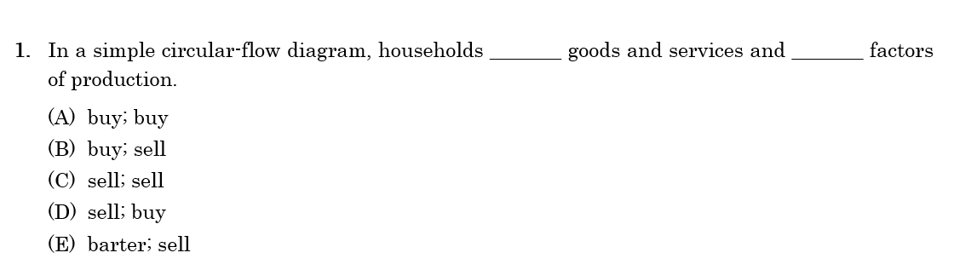
Answer: B
(400 Questions Series)

Slide 48
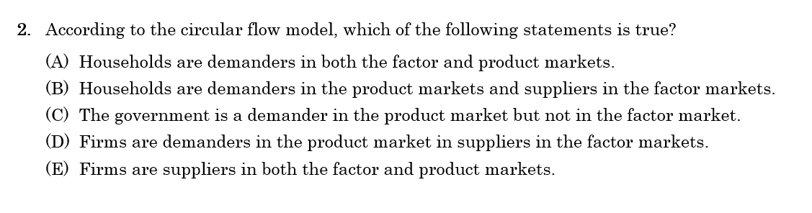
Answer: B

Slide 49
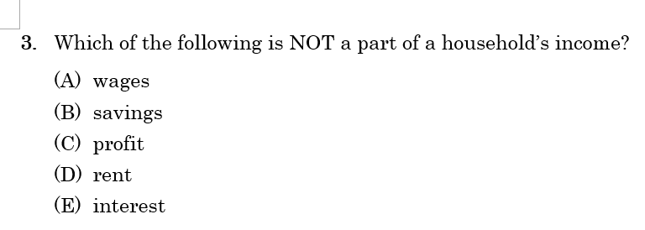
Answer: B

Slide 50
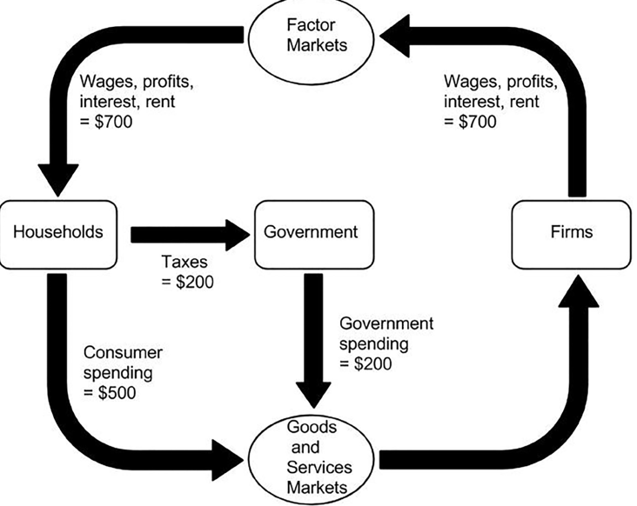
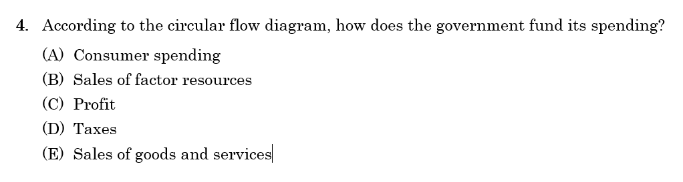
Answer: D

Slide 51
3 Ways of Measuring GDP (Gross Domestic Product)

Slide 52
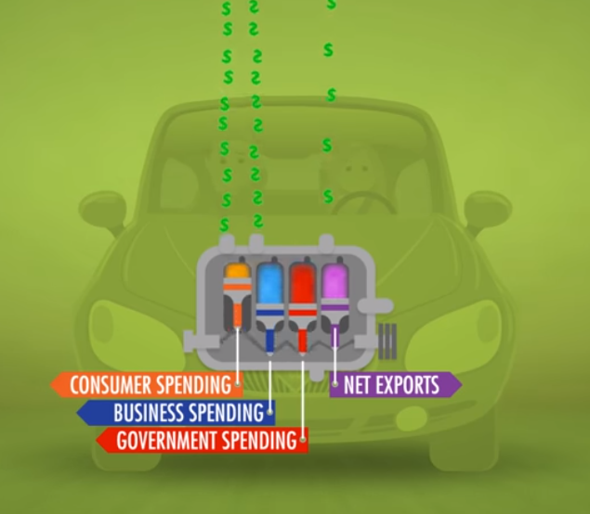
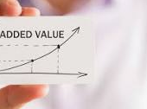
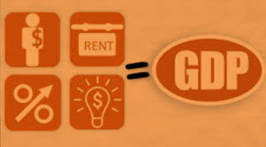
3 Ways of Calculating GDP (Gross Domestic Product)
Total Expenditure Method
Value Added Method
Factor Incomes Method
3 Ways of Calculating GDP

Slide 53
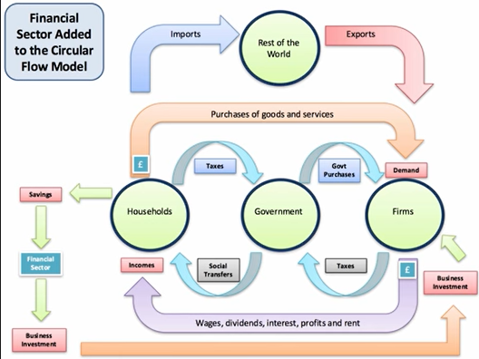
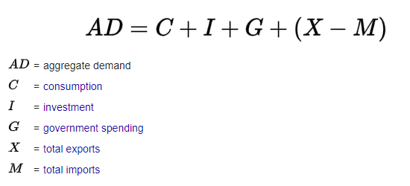
Total Expenditure
Expenditure is a way of measuring the total production in the economy. This makes sense because everything that is produced is satisfying the needs of the people in the economy.
So how much is spent in the economy in our circular flow?
Households
Firms
Government
Foreigners
Consumption, C
Investment, I
Y
GDP = C + I + G + (X-M)
Government Spending, G
Exports – Imports, (X-M)
Note: We don’t count businesses buying from households because that is essentially a trade between households and businesses (factors of production for goods) and so we only need to count one of them.
3 Ways of Calculating GDP

Slide 54
Circular Flow
Exports – Imports (X-M)
GDP = C + I + G + (X-M)
Consumption (C )
Government Spending (G)
Investment (I)

Slide 55
Sometimes we refer to spending in the economy as the engine of the economy.
If there is no more spending, then the economy doesn’t move!

Slide 56
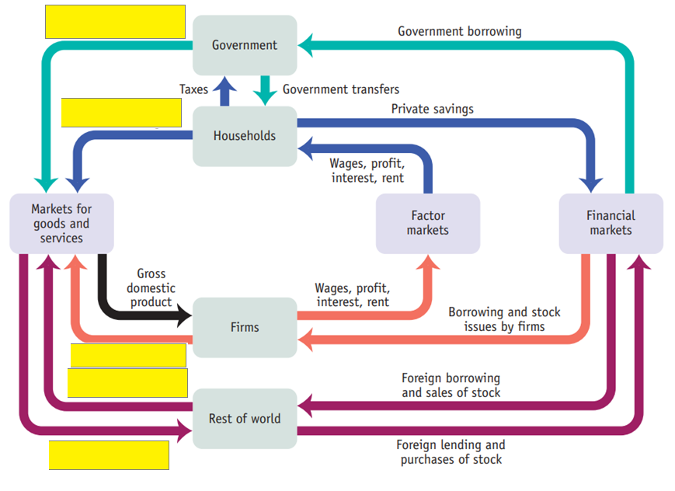
Government Spending - G
Consumption - C
Investment (I)
Exports (X)
Imports (M)

Slide 57
What are the types of expenditure used in the expenditure method of calculating GDP?
Consumption (Households)
Investment (Firms)
Government spending (government)
Exports – Imports (foreign buyers and local buyers)

Slide 58
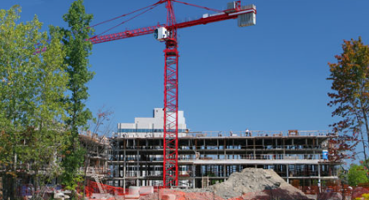
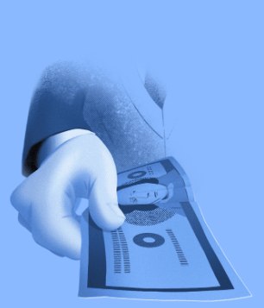
Government Expenditure
Government expenditures = All government spending of money
Government spending (G) = Government spending money on goods and services produced in that year, therefore it IS counted in GDP
Government transfers
Government Spending (G)
Government transfers = ‘taking money from the rich and to the poor’ through taxing wealthier people and paying it out through unemployment benefits, disability allowance, retirement payments etc. Because there are no goods and services being produced, it is not counted in GDP.
Government Expenditure = Government Spending + Government Transfer Payments

Slide 59
What is the difference between government expenditure and government spending?
Government spending is only spending on goods and services produced in that year and is therefore counted in GDP.
Government expenditure also includes government transfers (which are not included in GDP)
Gov Exp = Gov spending + gov transfers

Slide 60
3 Ways of Calculating GDP (Gross Domestic Product)
Total Expenditure Method
Value Added Method
Factor Incomes Method
3 Ways of Calculating GDP

Slide 61



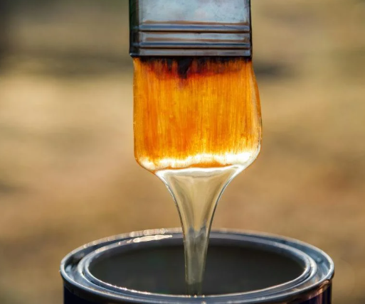

Value Added
3 Ways of Calculating GDP
Summary
The value added method takes the value that each business adds to their materials.
We can also measure the size of the economy through the value added by businesses at different stages of production.
Each level creates output which has a higher value than the input they received! This is adding value!
Note: We subtract the costs of production such as electricity etc. so the added value number will be smaller after this subtraction.
If we take the added value for all goods and services in the economy, we will find the GDP.
The value we get will be the same as with the expenditure method.
Value = $50
Firm adds/creates value
Value = $150

Slide 62
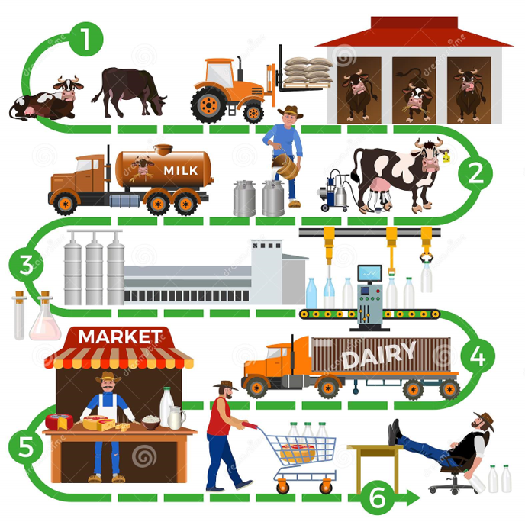
Example
A farm is able to use land and food to raise cows.
A company takes the milk and puts it into tanks and transports it.
A company takes the milk and treats and bottles it.
A transport company transports the bottles to a market where it can be bought conveniently as a final good!
We can see that each business is adding value so until we have our final good.

Slide 63
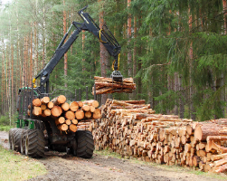
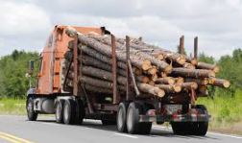
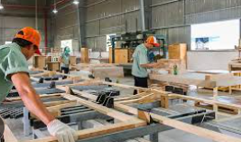

Example
A business turns a forest into timber.
A transport company brings the timber to where it needs to go.
A manufacturing company turns the timber into furniture.
A retailer puts the furniture in a room with salespeople and helps customers make the right decision.
1
2
3
4

Slide 64
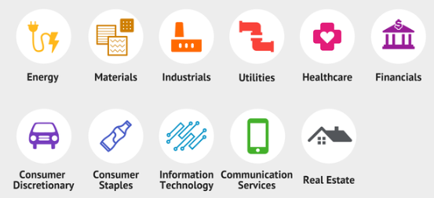

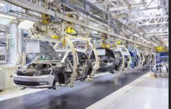

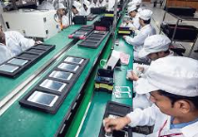
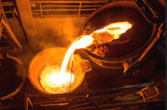
Each business in all industries is adding value by transforming or transporting goods and services into something that is more valuable, for the customer or for the next business.

Slide 65
What is the value added method of calculating GDP?
We measure the value added by each business in the chain of production.
Give an example of the value added in a chain of production?
A car.
A car company buys steel for $1000, rubber for $200 and an engine for $3000. They turn these inputs into a car and sell it for $10,000.
The value added in this case would be $6800. (Not including labor costs)

Slide 66
3 Ways of Calculating GDP (Gross Domestic Product)
Total Expenditure Method
Value Added Method
Factor Incomes Method
3 Ways of Calculating GDP

Slide 67
Factor Incomes method
All the income that the households earn through providing the factors of production is equal to the total output of the economy.
Factor payments/incomes
Land – rent
Labor – wage
Capital – interest
Entrepreneurship/Enterprise – profit
Think about it this way: the factors of production are the things that generate money and they are owned by the people. So the income that goes to the people must be the GDP.
Summary
The factor income method takes all the incomes earned by the people in the country. (Income comes from owning the 4 factors of production.)
3 Ways of Calculating GDP

Slide 68

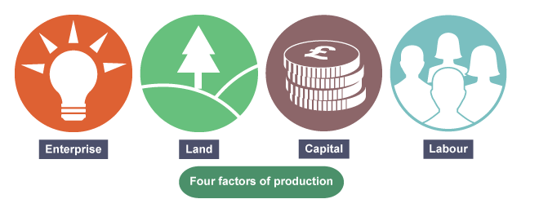

Resources (which are owned by the households) are used to make the value of our output, so they must be rewarded.
Summary
The resources are used to make the goods and services and so the payment that resources receive must be equal to what is produced.

Slide 69
Factor Incomes
Can be seen on the circular flow model.

Slide 70
What are the three methods of calculating GDP? Which is the most commonly used method?
Expenditure Method (C+I+G+(X-M))
Value added method
Income Method
The expenditure method is most common for AP Macro purposes.

Slide 71
3 Ways of Calculating GDP (Gross Domestic Product)
Total Expenditure Method
Value Added Method
Factor Incomes Method
3 Ways of Calculating GDP

Slide 72
Output = Expenditure = Income = Value
Summary
GDP = Output = Expenditure = Income = Value Added
Each of the three methods of calculating GDP. should give the same answer!
Expenditure Method = C+I+G+(X-M)
Why does this show GDP?
Because we are measuring what people are paying for the final goods and services.
People will only pay for the value that they receive!
Value Added Method
Why does this show GDP?
People will only buy from businesses if they offer something.
What they offer in terms of value is equal to what the customer pays, minus the costs of the business.
Income Method (All wages, rent, interest, profits)
Why does this show GDP?
The income comes from the work that the resources provide.
A resource only gets paid for what it gives.

Slide 73
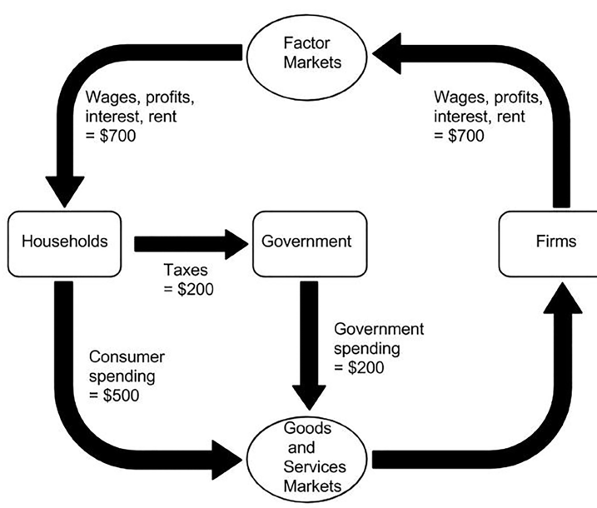
Question 5
According to the circular flow diagram, what is the GDP in this economy?
$200
$500
$700
$1200
$1600
Answer: C
Income method = wages, profits etc. = 700
Expenditure method: C+I+G+(X-M)
= C + G = 500 + 200 = 700

Slide 74

A) wrong – should be all final goods
B) wrong – should be C+I+G+(X-IM)
C) wrong – this is double counting
D) Wrong – strictly this should be income received by households… however I think this option is very tough because it is so close to correct. Another consideration is that some producers of final goods and services are foreigners and this shouldn’t be counted.
E) All of the above are slightly wrong.

Slide 75
If real total production in the economy in one year is equal to $5 billion, what is the real income?
Also $5 Billion, because real output = RGDP = real income.

Slide 76
Counted and Not Counted in GDP

Slide 77
Learning Objectives Checklist
Understand what is excluded from GDP statistics
Intermediate Goods
Non-newly produced goods
Financial Markets
Informal Markets
Environmental Events

Slide 78








Not Counted in Gross Domestic Product
Intermediate goods (Finished goods only)
eg. We don’t count the flour that the baker buys to make their bread (double counting) video link
Things not produced in that year
2nd hand goods not counted
Financial assets
these represent change of ownership or borrowing but no production
This applies to all financial products.
Non-market activities (ppt section)
Shadow economy
Eg. A plumber fixes a friend’s sink
A farmer sells fruit at the side of a road
Illegal activities
Transfer Payments
Money that is transferred without any goods and services produced
Eg. Gov transfers to the poor
Eg. You donate to charity
Environmental Things
Eg. Polar bears are born or a rainforest is cut down (should affect GDP but is not counted because nature cannot pay money for a good/service)
Baby seal THANKS his rescuers - YouTube

Slide 79

Intermediate Goods - Problem: Double Counting GDP
We only count the final goods and services.
Otherwise we will count them twice.
The goods and services that are used to make goods and services are not counted.
Eg. A loaf of bread. We don’t count the flour, salt, water etc.
Summary
Do not count intermediate production, only the final goods, otherwise we would ‘double count’.

Slide 80




Non Market Activities: Informal/Underground/Hidden/Shadow/Grey Economy
GDP is only made up of things that can be measured by the government agencies.
Cash transactions or barter (swapping goods) are less likely to be visible to the government.
Things that may not be measured:
Barter and cash transactions that occur outside recorded marketplaces are not included in the general GDP statistics. These activities can be legal and can generate incomes.
Such activities may occur in order to avoid recording income to avoid paying taxes.
For example, a full-time plumber who works extra hours outside his shift may not declare the additional income he received from this task.
Illegal activities, such as dealing with illegal drugs or working as an illegal immigrant. This is often called the ‘black market.’
Particularly in poorer countries, many communities exist ‘off the grid’, growing enough just to support themselves. This is referred to as subsistence agriculture. And would also not be recorded in official GDP measures.
Many goods and services are not legal but are still sold widely.
In many parts of the world, communities live off growing their own food and are not measured by the government.
Summary
GDP only shows what the government can measure. Many activities that have monetary value simply aren’t measured in official GDP measures.

Slide 81

Factors that influence the size of non-market economies
Link
Informal economy: More than 60 per cent of the world’s employed population are in the informal economy (ilo.org)
The size of informal economies and non-marketed output is influenced by the following factors:
The number of activities that are officially declared illegal.
Tax rates, because the higher the tax rates, the more likely tax evasion and the omission of transactions.
The penalties for tax evasion and avoidance.
The number of tasks people perform for themselves and the output generated.
The size of subsistence agriculture.
Government record keeping (eg. many citizens may have no official records/documents)
Summary
Different factors will affect how much of a country’s economy is in the shadow market.

Slide 82

Greece's tax fraud problem | DW Documentary - YouTube

Slide 83
What is one factor that would contribute to the size of the shadow economy?
Tax rates – higher tax rates will lead to tax avoidance
Level of crime
Number of Subsistence Agricultural communities
Amount of unpaid production – eg. Volunteer work.

Slide 84
GDP – What is counted and not counted videos
Finished goods only
Non Market Transactions Link

Slide 85
What are two things not counted in GDP?
2nd hand goods
Intermediate goods (eg. a car is worth $10K but we don’t also count the steel that was sold to the car maker)
Non-market activities

Slide 86

Check your Understanding Module 10
This would be double counting!
The steel should only be counted in the final product of the car, we shouldn’t count the intermediate good.

Slide 87



Unsold Goods - Investment
Inventories
Inventories is the amount of goods that are available to be sold and used.
Eg. A shoe store has many boxes of shoes that it puts on its shelves to be available for customers to buy.
If something is produced in a year but it NOT sold, then how is it measured in GDP?
We cannot measure it the next year because it will not be newly produced.
The answer is that is recognized as investment.
We assume, that when businesses produce and keep the product to be sold later, they are investing in their inventories.
The business is investing in itself! In order to have more things to sell.
Summary
Things that are made but not sold in the same year are counted as investment (inventory investment)

Slide 88

Note:
Of course, the car will probably be sold for a ‘mark up’ and so this mark up, and the service offered by the sales person would be counted in GDP.
However, in this question, nothing is stated about this so we can assume the car is sold for the same value as it was recorded in 2006.
Answer: C.
When the car is produced in 2006 it is counted as investment. (because the car will be later sold and is counted as inventory)
When the car is sold the next year, it was already counted in 2006’s GDP as investment so there is no change.

Slide 89

GDP as a Statistic - Societal Issues
Summary
GDP is an important statistic but does not tell us much about certain social issues in society.
Many important social indicators are not accounted for in GDP.
A country could have a very high GDP which might indicate that the country is doing well.
However, there could be problems in that society that we cannot see from the GDP number.
GDP is just one indicator.
Societal Issues Examples
Health
infant mortality
morbidity
suicide rates
Quality of life
loss of leisure time
cost of commuting to work
lack of civility in communities
Crime and other problems
crime
environmental health/decay and destruction of the natural environment
family breakdown
Equality
lack of concern for future generations
income gap (women/men; poor/wealthy)
poverty

Slide 90
Is GDP an important statistic that can give a lot of valid information about the state of the economy?
Yes.
Can GDP be used to give a detailed understanding of specific social issues such as crime or health?
No.

Slide 91
Mark the following transactions as counted or not counted in China’s GDP:
Sale of a second hand car.
You stay in a hotel in Shanghai.
A friend helps you fix your car as a favor.
Sale of an American movie to a Chinese citizen.
We work in a factory and get paid our weekly wage.
Sale of Baidu stocks.
A fruit vendor sells an apple on the street but doesn’t pay tax because it is unrecorded.
A management consultant works for Coca Cola and is paid for a month’s work.
Your husband/wife cooks you a delicious meal.
No
Yes
No
No
Yes
No
No
Yes
No

Slide 92

A. Yes, it is investment.
B. No, because it is not new production. It is an old plane.
C. No. Financial assets are not counted.
d. Yes, it is an export.
E. No, it is an import. So it is counted in France’s GDP.
F. Yes, it is counted as investment.

Slide 93
Link (Whole MRU Video on GDP)

Slide 94

Krugman Multiple Choice
A – because this is investment spending for a business.
C
B – imports are a leakage.
E
A – should be final goods
B – X should be included
C – no, double counting.
D – should be total income for households.
A – it’s about 60%
(Investment is about 20%)

Slide 95
GDP Summary
Not Counted in GDP
Intermediate goods (Finished goods only)
eg. We don’t count the flour that the baker buys to make their bread (double counting) video link
Things not produced in that year
2nd hand goods not counted
Financial assets
these represent change of ownership or borrowing but no production
Non-market activities (ppt section)
Shadow economy
Eg. A plumber fixes a friend’s sink
A farmer sells fruit at the side of a road
Illegal activities
Environmental Things
polar bears are born
a rainforest is cut down (should decrease GDP but is not counted)
Three Methods of Measuring GDP
Total Expenditure Method
Value Added Method
Factor Incomes Method
Circular Flow

Slide 96


Depreciation
In economics, when we refer to ‘depreciation’ we are typically referring to the decrease in value of equipment and machinery.
Eg. A delivery truck is bought in 2015. After 7 years of use, it no longer drives as well as it used to and so you cannot do as many deliveries. The value of the truck has therefore decreased.
This can also be called by obsolescence, when new technologies emerge to make the equipment not as valuable.
Therefore with depreciation, investment is needed to repair/fix the worn out capital.
Above: Loss of value though ‘wear and tear’ and exposure to weather etc.
Summary
Depreciation = loss of value of capital stock. This will affect the LRAS.

Slide 97
What is depreciation? What effect does it have on the stock of capital goods in the economy?
Depreciation is a decrease in the value of things, often through use/wear and tear.
It causes a decrease in the value of capital goods in the economy.
If there is depreciation of $1 million dollars, and only 700K of investment in 1 year, what happens to the amount of capital stock (amount of capital goods)?
The total value of capital stock decreases by 300K.

Slide 98

Disposable Income
Some questions in the any AP exam ask about disposable income. Disposal income is simply your gross income (total income) minus personal taxes.
The rest is considered income that you have at your disposal to spend therefore: disposable income.
Disposable Income = Gross Income – Personal Taxes
Note: Some forms of tax are referred to as insurance such as health insurance (tax that is paid toward the health system).
Summary
Disposable income = gross income – personal taxes.

Slide 99
What is disposable income if you earn $50,000 and pay 20% of this in the form of tax?
Disposable Income = Gross Income - Tax = 50,000 x (1-0.2) = 40,000

Slide 100
The Business Cycle
We will do a brief crash course on the business cycle but we will come back to it later in the unit!

Slide 101
Learning Objectives Checklist
Understand terms relating to the business cycle
Expansion, Contraction, Recession, Peak, Trough
Effect of Expansions and Contractions on Unemployment
Expansion -> Decrease Unemployment
Contraction -> Increase Unemployment
Bonus: The debt cycle and effect on the business cycle

Slide 102


Business Cycle
Chinese
Business Cycle (You’ll Love Economics)
Summary
The business cycle refers to the ‘up and down’ pattern of the economy.
Business Cycle: the movement of business production in an ‘up and down’ pattern
The economy is sometimes growing and other times shrinking.
Just like human beings who are sometimes happy, sad and sometimes in the middle, the economy follows a similar pattern.

Slide 103



Potential output is the ‘good, healthy level’ of the economy.
Note: Real Output is the same as Real GDP!
Note: Because technology and productivity is generally increasing (eg. better machines, faster computers, faster planes and trains), GDP usually increases over time, so the trend growth or potential output is upward sloping.
Trend line

Slide 104

Draw the business cycle. What goes on the y axis? What goes on the x axis?
Y axis, GDP/real output
X axis, time
What is the difference between the Actual Output and the Potential Output?
Actual Output is what we observe in our economy and Potential Output can be considered the ‘average’.
Eg. You usually get a 91% grade but this quiz you got a 96% and the previous quiz you got a 86%.

Slide 105

Contractions and Recessions
Summary
Contraction – negative economic growth.
Recession – 6 months of negative GDP growth
Depression – a bad recession
Unemployment increases in each case.
Key terms:
Contraction – negative economic growth.
Recession: two or more quarters (6 months) of negative economic growth (fall in GDP).
Depression – has no technical meaning, but is a severe recession.
If the periods in red last for more than 6 months, then it is considered a recession.
Consequences:
Unemployment rises as business are not doing well and have to cut costs
Falling demand by consumers leads to falling profits and businesses closing down.
Business confidence falls leading to less investment in new and existing business.
Decline in economic activity until reaches a minimum (slump)

Slide 106

Business Cycle
Key term:
Expansion: Economic activity increases and will finish by reaching the highest point called a peak. Expansion is sometimes called a ‘boom’
Summary
Expansion – positive economic growth – GDP increases.
Unemployment decreases in an expansion.
Decreased unemployment rate due to more business activity
Business investments and profits are at their highest levels
Most sectors are producing at a higher rate
High level of business demand

Slide 107
Business Cycle and Economic Indicators Summary
Expansion
GDP ↑
Unemployment ↓
Contraction
GDP ↓
Unemployment ↑
Bonus: Consider what happens to inflation?
(Usually but not always - Expansion: Inflation increases, Contraction: Inflation decreases)

Slide 108
What is the highest point of the business cycle?
Peak
What is the lowest point of the business cycle?
Trough
What is the definition of a recession?
Negative economic growth ie. decrease in GDP for more than 6 months.
What happens to unemployment during a recession/contraction of the business cycle?
Unemployment increases.
What happens to unemployment during an expansionary period of the business cycle?
Unemployment decreases.
What do we call the output at the ‘good, healthy level’ of the economy?
Potential output
What do we call the output that we actually observe?
Actual Output

Slide 109


Bonus: Why Do We Have Business Cycles?
The business cycle occurs for a variety of reasons, most importantly levels of debt through the economy.
Borrowing today means we can spend more now but we must spend less in the future.
This is true for one person but also for the whole economy!
We often refer to this as a Debt cycle

